Slide 1
Storyboarding Workshop
15th August 2024

Slide 2
By telling a story of how someone might use a feature, we are able to put ourselves in the footsteps of the user and imagine how we might behave in this situation.
Why are we doing this?​
​
To think about our ideas from the user's perspective and to discuss them in more detail
To roughly test ideas

Slide 3
Storyboarding
Break into small groups
You need a sheet of paper with squares. In each square, draw each step of how someone would use this feature.
Each square should have one sentence description of what is happening.
Once you have finished your storyboard, take a photo and send it on the meeting chat.
Each team will present their storyboard, talking through each step to explain how the idea might work.

Slide 4
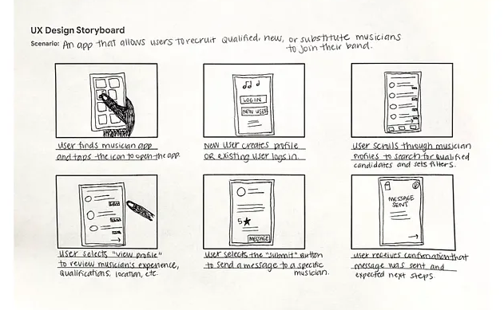
Storyboard examples

Slide 5
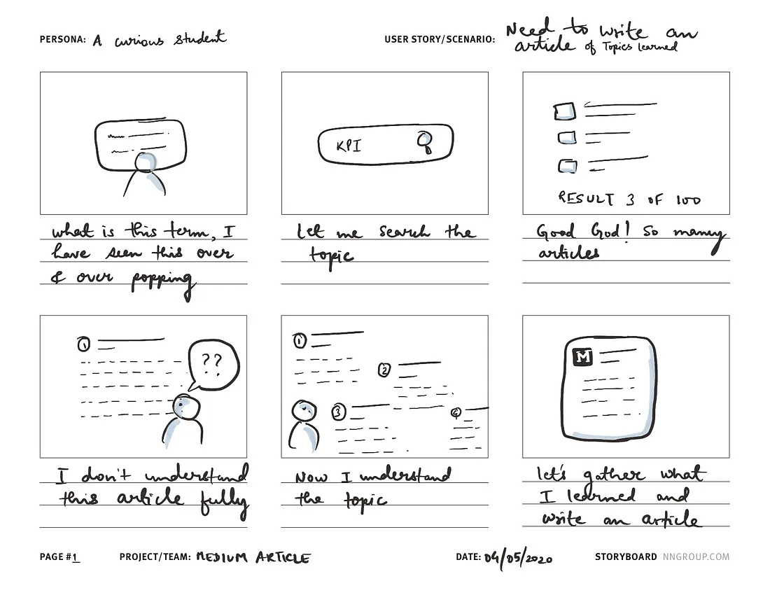
Storyboard examples

Slide 6
Agenda
2:00pm – 2:10pm - Presentation
2:10pm – 2:50pm - Storyboarding
2:50pm – 2:55pm - Take a photo of your storyboard and send it on the meeting chat.
2:55pm – 3:30pm - Each group to present their storyboards

Slide 7
Idea 1
A feature that allows users to enter any question or search terms, e.g. ‘Person X murdered person Y yesterday at 2 o’clock in Town A’ and the relevant results are returned from news articles and social media posts. It will also suggest content based on the user’s previous searches and interests.
Team 1: Adam, Colin, Tahira, JT, Sundus (standup area near kitchen)
Team 2: Asiyah, Phil, Josh, Vijaya (standup area)

Slide 8
Idea 2
A feature that alerts users when there’s a spike in the usage of specific terms such as ‘protests’, ‘stabbing’, ‘gun’ or ‘racist comments’ in a particular area or location.
Team 3: Tom, Gladys, Aarthi, Mike, Charanpreet (seating area next to Tom’s desk)
Team 4: Charles, Neil, Victoria, Lewis (desk’s close to JT’s room)

Slide 9
Thank you

